Slide 1





OPEN BUS TRANSMIT
Presented by:
Dhruv Patel (MT23056)
Harshkuamr Patel (MT23037)
Kantilal Patel (MT23063)
Aryan Joshi (2020036)

Slide 2


Introduction
Our Android app transforms bus tracking, providing real-time updates and detailed routes for a seamless travel experience. It caters to two scenarios: "Inside Bus" for onboard users and "Outside Bus" for trip planning. With GPS, onboard users can find their location, nearest stops, and complete route maps. For external users, the app offers precise navigation, time management, and journey updates. This report explores our app's design, functionality, and user-centric features, enhancing travel convenience.

Slide 3




App interface for user
inside bus or outside bus
This button is useful because it allows us to determine whether the user is traveling inside the bus or outside the bus
list of the routes
iIf the user is inside the bus, the application will display the current route of the bus and the next stop. If the user is outside the bus, it will show the selected route.
Map
All stations are shown on the map, and users can find the distance between their current location and each station on Google Maps

Slide 4





Services
LocationManager
current time
google map
Use this class to request location updates and manage the device's location providers (GPS, network-based, etc.).
To find the current time of the user in an Android application, you can use the System.currentTimeMillis() method. You can then manipulate this time as needed to display it in various formats or perform time-related calculations.
The primary service for integrating Google Maps into an Android app is the Google Maps Android API, offering features like map display, markers, polylines, and location services. It includes classes like GoogleMap, MapFragment, Marker, PolylineOptions, and CameraUpdate for map customization and interaction.

Slide 5
User Experience
Users appreciate the convenience of GPS-based location detection within the bus, as it provides accurate and real-time information on their whereabouts.
The interface components for source and destination selection have been well-received, offering both manual input and predefined options for enhanced usability...
Users find the display of available routes and buses based on their selection to be informative and helpful in planning their journeys.
The integration with Google Maps for detailed route information has garnered positive feedback, particularly for its clarity and ease of use in navigating upcoming stations.

Slide 6
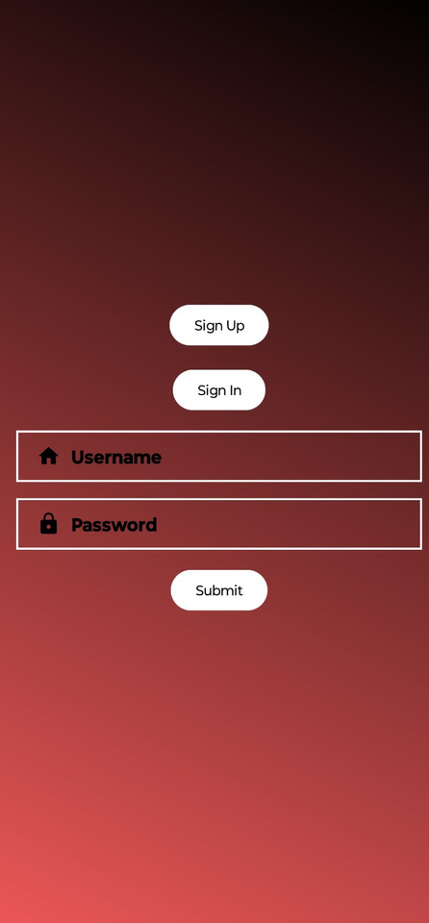
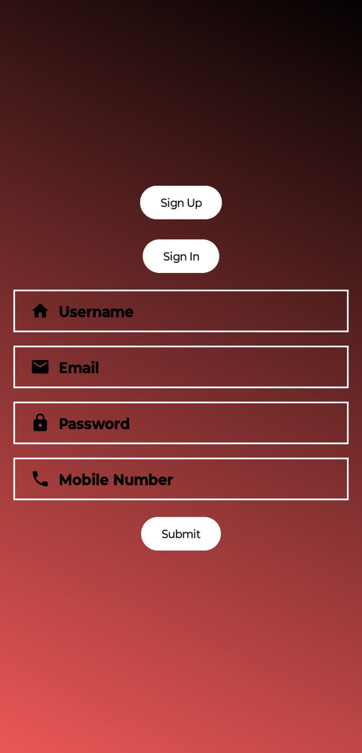
Login Page

Slide 7
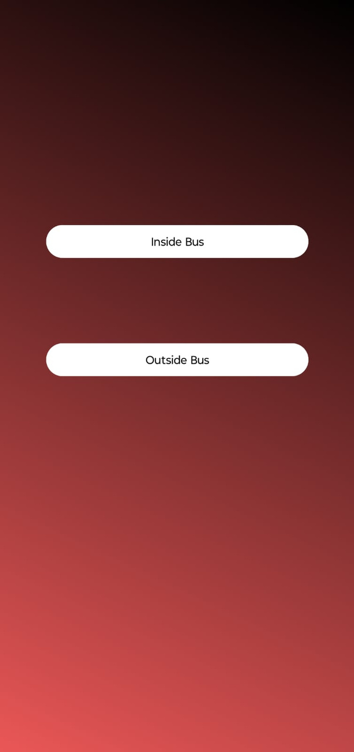
in side bus or outside bus

Slide 8
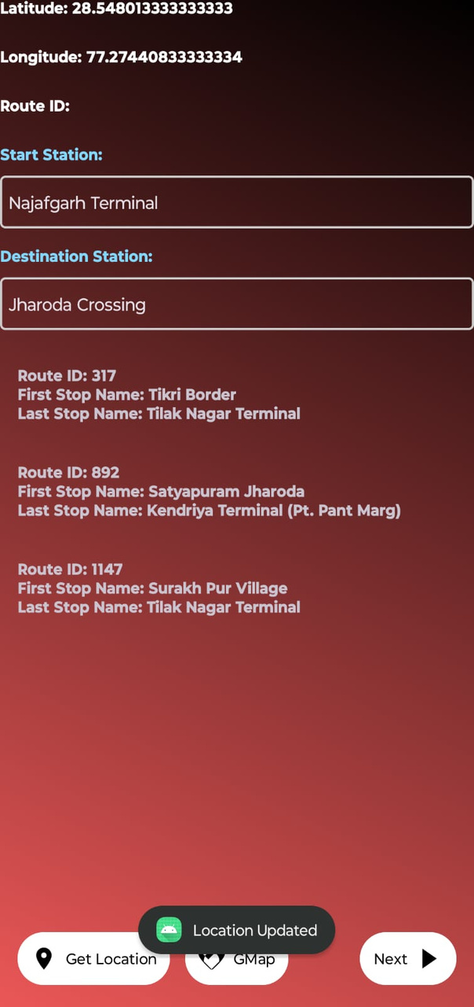
IN SIDE BUS

Slide 9
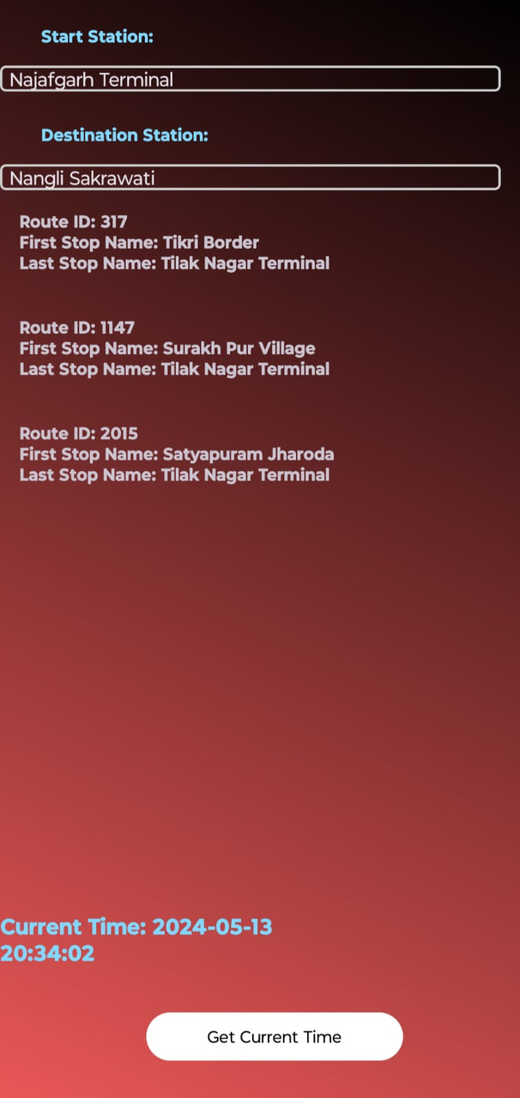
OUTSIDE BUS

Slide 10
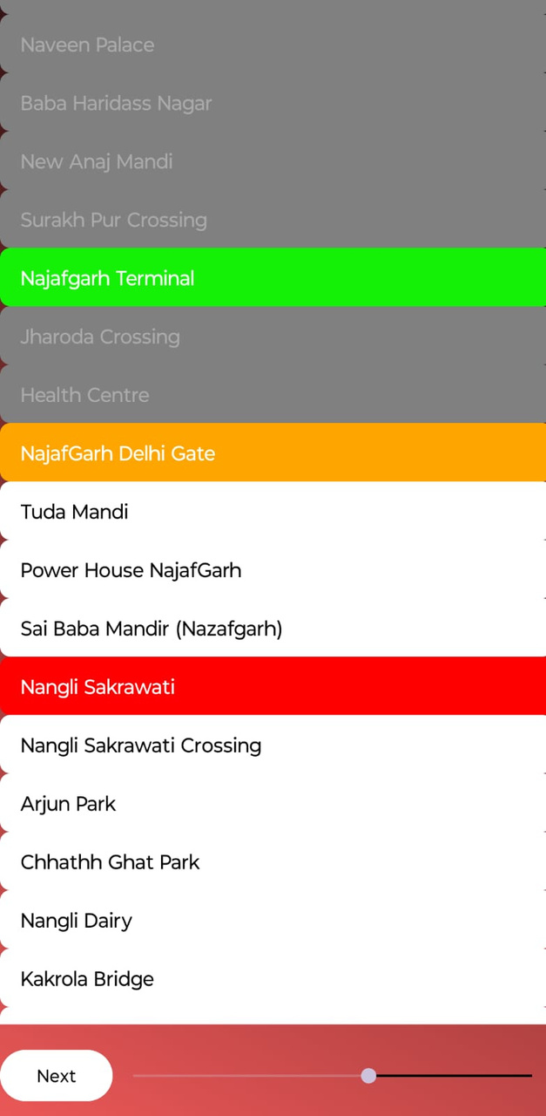
List of station

Slide 11
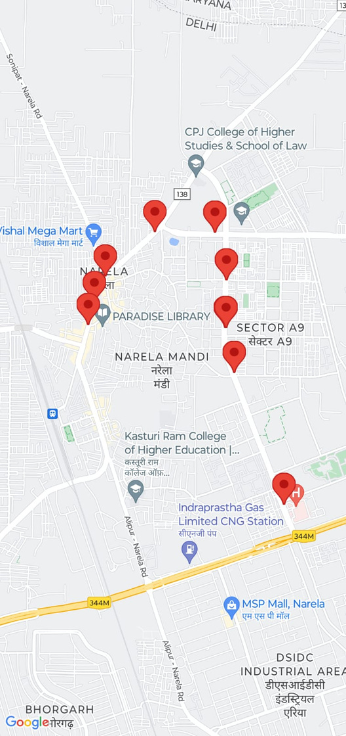
station marker on map

Slide 12
THANK YOU

